Slide 1
Lecture 5 Software Engineering System Modeling
Dr. Mohamed ElAraby

Slide 2
Agenda
Requirement Engineering
Functional Requirements
Non-Functional Requirements
UML Introduction
UML Diagrams types
Interaction Models
Use Case Modeling

Slide 3
Requirement Engineering
The process of finding out, analyzing, documenting and checking these services and constraints.
In some cases, a requirement is simply a high-level, abstract statement of a service that a system should provide or a constraint on a system. At the other extreme, it is a detailed, formal definition of a system function.

Slide 4
Requirement Engineering
Example:
If a company wishes to let a contract for a large software development project, it must define its needs in a sufficiently abstract way that a solution is not predefined.
The requirements must be written so that several contractors can bid for the contract, offering, perhaps, different ways of meeting the client organization’s needs.
Once a contract has been awarded, the contractor must write a system definition for the client in more detail so that the client understands and can validate what the software will do. Both of these documents may be called the requirements document for the system.

Slide 5
Requirement Engineering
Some of the problems that arise during the requirements engineering process are a result of failing to make a clear separation between these different levels of description.
Distinguish between them by using the term
‘user requirements’ to mean the high-level abstract requirements and
‘system requirements’ to mean the detailed description of what the system should do.

Slide 6
Requirement Engineering
User requirements are statements, in a natural language plus diagrams, of what services the system is expected to provide to system users and the constraints under which it must operate.
System requirements are more detailed descriptions of the software system’s functions, services, and operational constraints. The system requirements document (sometimes called a functional specification) should define exactly what is to be implemented. It may be part of the contract between the system buyer and the software developers.

Slide 7
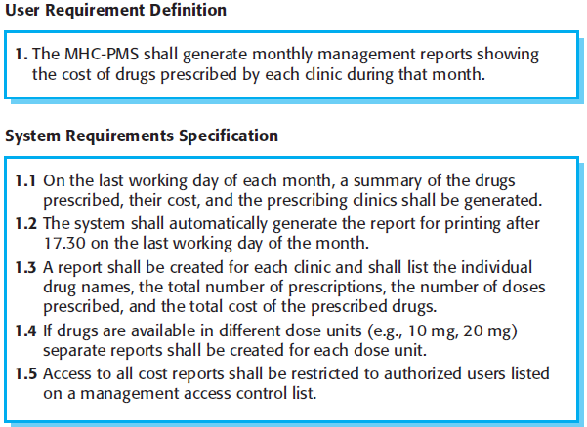

Slide 8
Software System Requirements
Functional requirements
These are statements of services the system should provide, how the system should react to particular inputs, and how the system should behave in particular situations.
In some cases, the functional requirements may also explicitly state what the system should not do.
Non-functional requirements
These are constraints on the services or functions offered by the system.
They include timing constraints, constraints on the development process, and constraints imposed by standards.
Non-functional requirements often apply to the system as a whole, rather than individual system features or services.

Slide 9
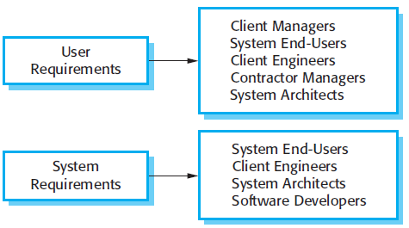
Readers of requirements specification

Slide 10
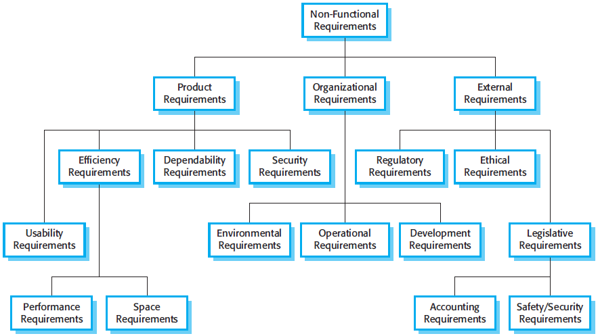

Slide 11
UML Introduction
System Modeling mean representing the system using some kind of graphical notation, which is now almost always based on notations in the Unified Modeling Language (UML).
In a model-driven engineering process, it is possible to generate a complete or partial system implementation from the system model.

Slide 12
UML Introduction
Models of the existing system : clarify what the existing system does and can be used as a basis for discussing its strengths and weaknesses. These then lead to requirements for the new system.
Models of the new system : explain the proposed requirements to other system stakeholders. Engineers use these models to discuss design proposals and to document the system for implementation.

Slide 13
UML Introduction
Different models to represent the system from different perspectives :
An external perspective, where you model the context or environment of the system.
An interaction perspective, where you model the interactions between a system and its environment or between the components of a system.
A structural perspective, where you model the organization of a system or the structure of the data that is processed by the system.
A behavioral perspective, where you model the dynamic behavior of the system and how it responds to events.

Slide 14
UML (Unified Modeling Language)
Used in object oriented software engineering.
A rich language that can be used to model an application structures, behavior and even business processes.
There are 14 UML diagram types to help you model these behavior.
They can be divided into two main categories structure diagrams and behavioral diagrams.

Slide 15
UML Diagram Types
Structure diagrams show the things in a system being modeled.
In a more technical term they show different objects in a system.
Behavioral diagrams shows what should happen in a system.
They describe how the objects interact with each other to create a functioning system.

Slide 16
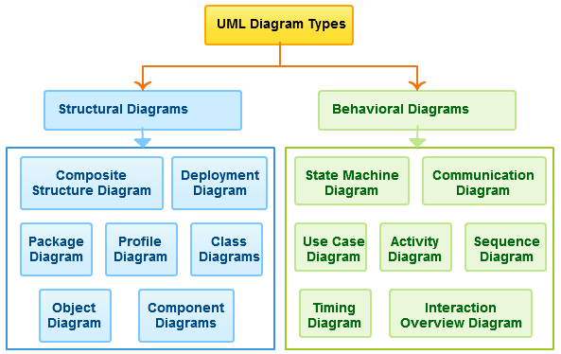

Slide 17
UML Introduction
Five diagram types could represent the essentials of a system:
Activity diagrams, which show the activities involved in a process or in data processing.
Use case diagrams, which show the interactions between a system and its environment.
Sequence diagrams, which show interactions between actors and the system and between system components.
Class diagrams, which show the object classes in the system and the associations between these classes.
State diagrams, which show how the system reacts to internal and external events.

Slide 18
Interaction models
Use case modeling, which is mostly used to model interactions between a system and external actors (users or other systems).
Sequence diagrams, which are used to model interactions between system components, although external agents may also be included.

Slide 19
Interaction models: Use Case Diagram
Most known diagram type of the behavioral UML diagrams,
Use case diagrams gives a graphic overview of the actors involved in a system,
Different functions needed by those actors and how these different functions are interacted.
It’s a great starting point for any project discussion because you can easily identify the main actors involved and the main processes of the system.

Slide 20

Interaction models: Use Case Diagram
Use case modeling is widely used to support requirements elicitation.
A use case can be taken as a simple scenario that describes what a user expects from a system.
Each use case represents a discrete task that involves external interaction with a system.

Slide 21
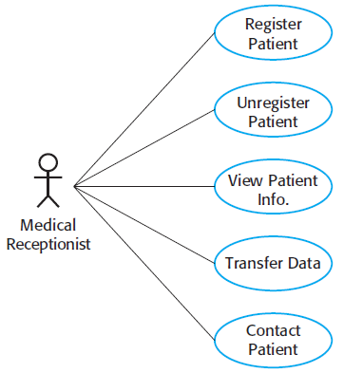
Use cases involving the role ‘medical receptionist’

Slide 22
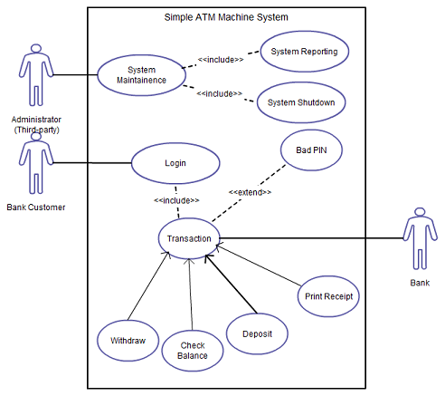
Use Case diagram showing Actors and main processes

Slide 23
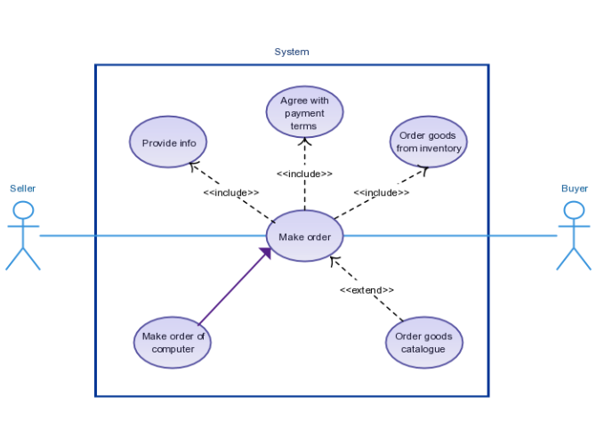

Slide 24
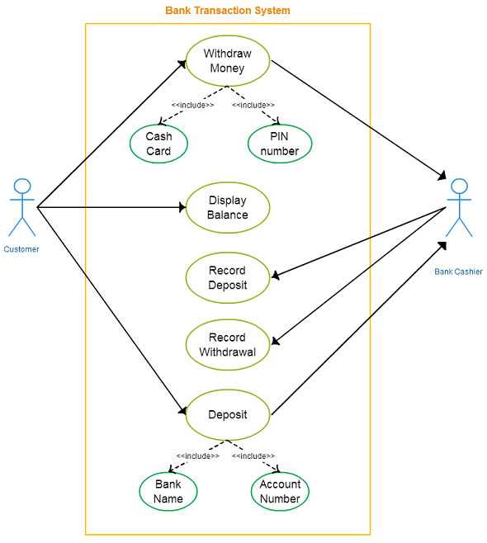

Slide 25
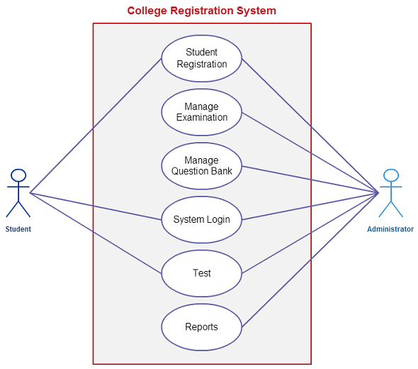
the system of student’s registration process in a collage

Slide 26
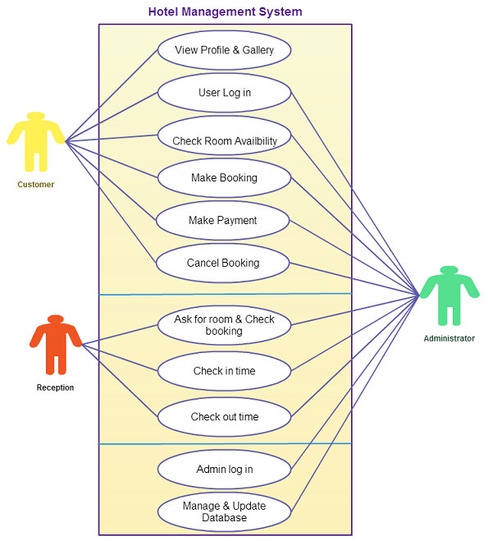
Use case diagrams with multiple subjects

Slide 27
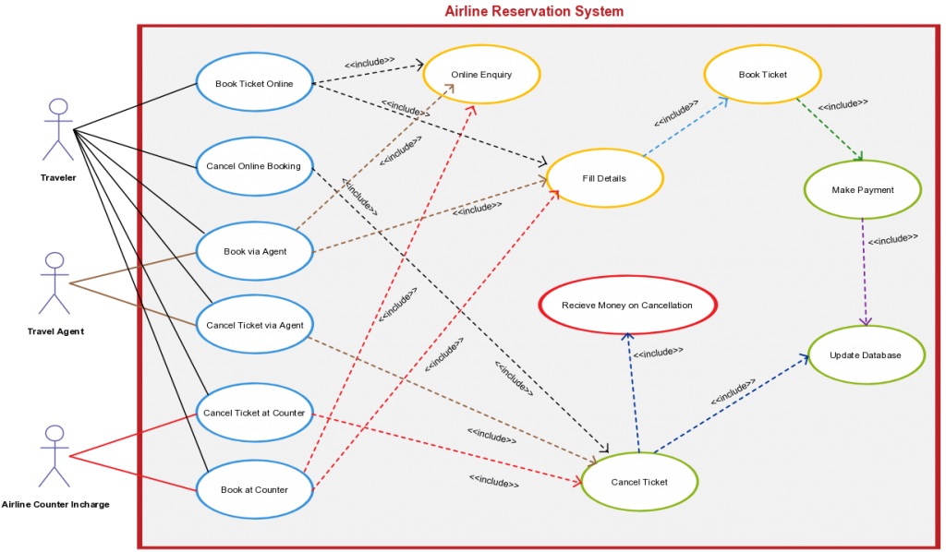
Airline reservation systems are very complex

Slide 28
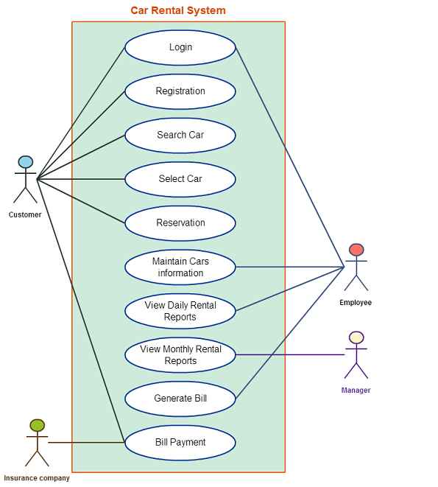

Slide 29
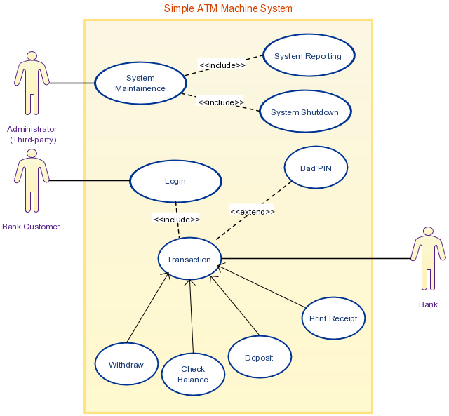

Slide 30
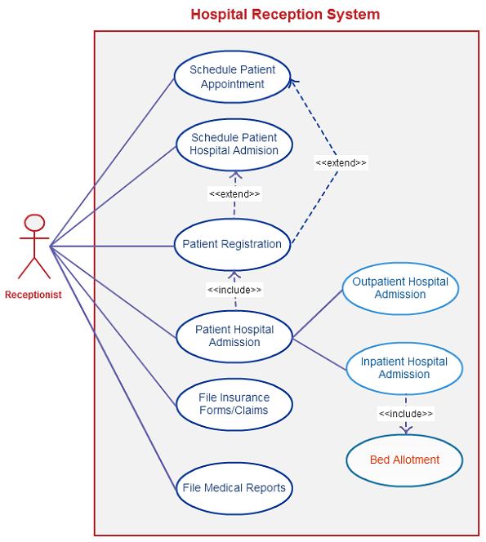

Slide 31
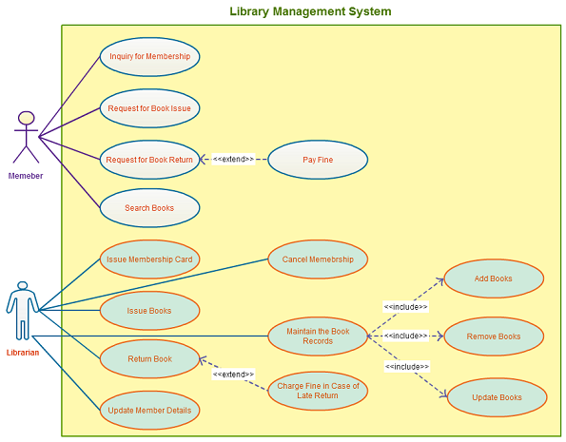

Slide 32
Any Question?

